Slide 1
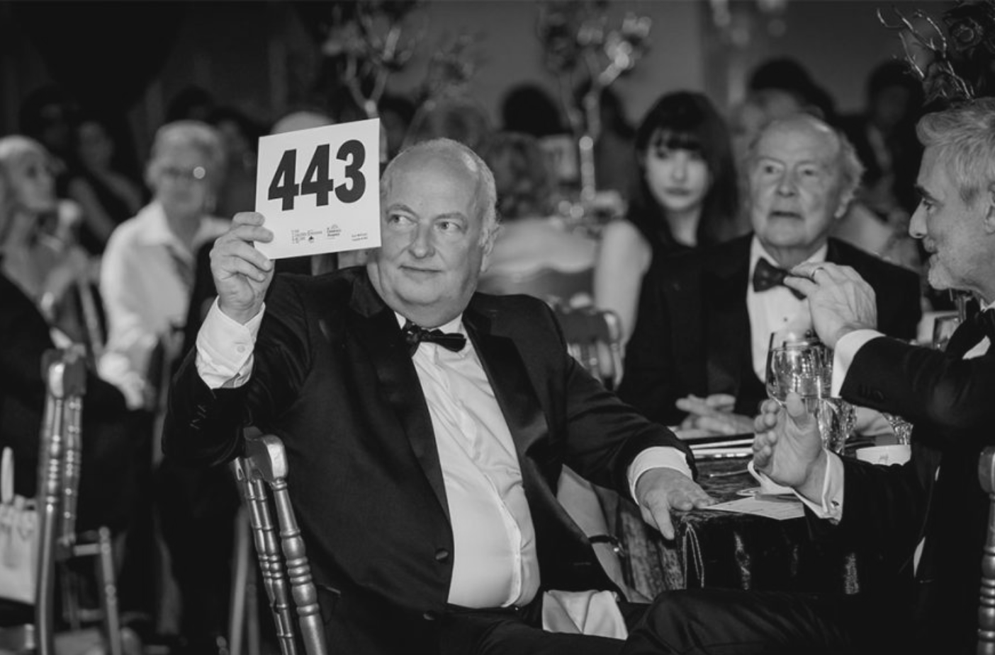



Maximizing Event Impact: Engaging Major Donors with Purpose
Brought to you by
Beth Ann Locke
DIRECTOR OF THE ACADEMY, GAIL PERRY GROUP for

Slide 2
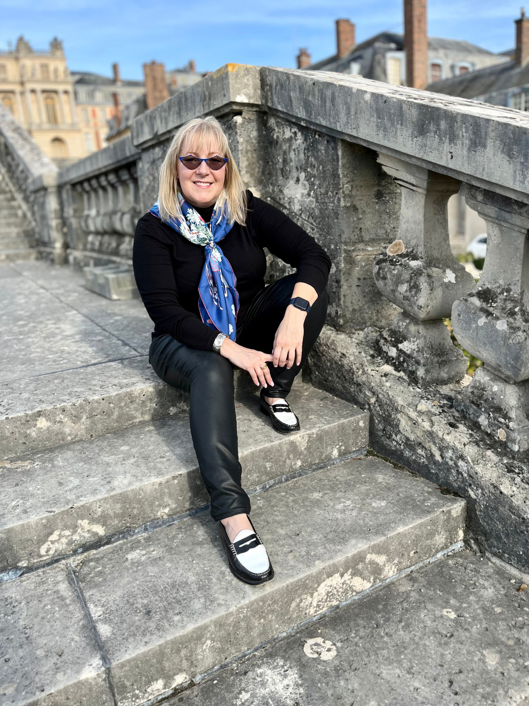









Beth Ann Locke
THE FUNDRAISER COACH
I became a fundraiser to change the world for the better.
As a fundraiser for 25 years, I learned that when donors see themselves as partners, rather than just contributors, their generosity knows no bounds. It's about connecting with values and creating impact together, hand in hand.
Now, I equip and guide fundraisers and nonprofit leaders, to showing them how to unlock more significant gifts and collaborate with high-net-worth individuals.
TRUSTED BY

Slide 3
Today’s Agenda
Why We Love Major Donor Work at Events
Here’s everything we’ll cover today:
Before the event
During the event
After the evnt
Final thoughts

Slide 4

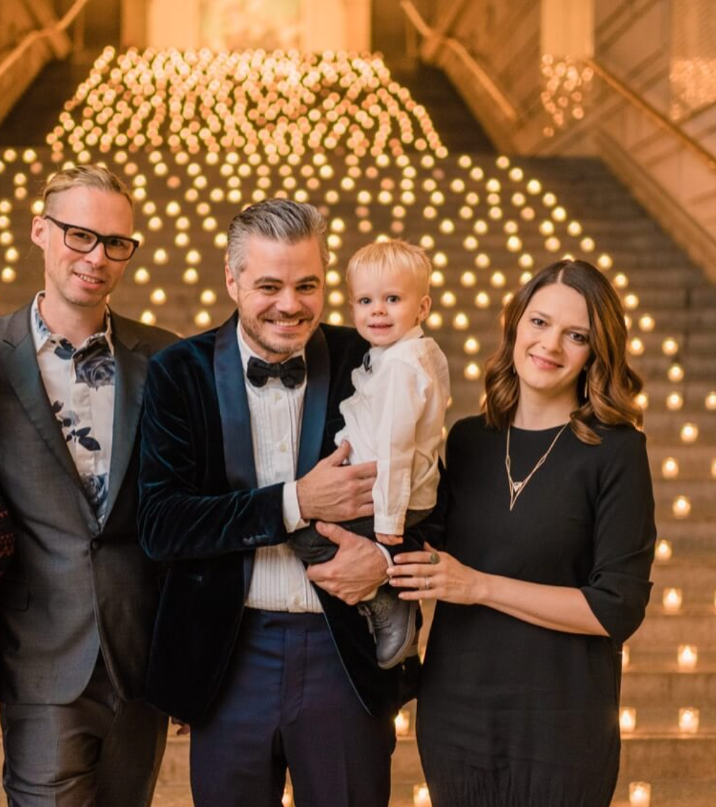
Why we love events
Events and auctions create opportunity...
  Elusive Donors Become Accessible
  Unexpected Connections May Happen
  Events Spark Community and Meaning
  Organic Conversations Thrive

Slide 5

Before the Event

Slide 6
Add Purpose by Shifting from
a Shopping Experience to
a Mission-Driven Experience

Slide 7
Shift Your Event to a Mission-Driven Experience
to Catalyze Giving
1
2
3
Tell Stories of Impact
Add Meaningful Items
Raise-The-Paddle
Highlight stories of impact throughout the event (use videos, images, and live testimonials). Incorporate a powerful mission moment ahead of the Ask.
Feature auction items related to the mission:
a basket of toiletries for domestic violence clients,
pet food for an animal charity, textbooks for a students.
If you haven’t yet instituted a Raise-the-Paddle strategy, consider it now to allow more philanthropic dollars to be raised - and raised
for purpose!

Slide 8
Most of Your Major Gifts Occurring at Events? Start Making Asks Earlier

Slide 9
Identify key major gift donors and ask them to commit to raising the paddle first or at a higher level
1
2
3
Raise-The-Paddle
Pre-Event Outreach
Offer Choice
If your RTP levels have been the same for several years, consider raising the top level and asking one of your major donors to commit to making the first “bid.”
Your Ask could be:
“We are considering moving the top bid level from $5,000 to $10,000. Would you consider being a first bidder at that level?” (Sip water.)
Your ask could be:
“We are considering moving the top bid level from $5,000 to $10,000. Would you consider being a first bidder at that level?” (Sip water.)

Slide 10
Strategically Involve Your CEO
with Key Major Gift Moves

Slide 11
Maximize the event with CEO-led donor moves management; curate a short list of supporters
1
2
3
Curate a List
Partner with the CEO
Make the Introduction
Fundraisers must curate a priority list of 5-15 guests; Name(s), a short recap on history and gifts, and the suggested move. [You may still be awaiting rsvps.]
Share the list with the CEO over a discussion and add any additional notes or insights from both sides; ensure and they have everything they need to know.
The fundraisers should facilitate introductions between the CEO and the donors or prospects during the event to ensure these conversations happen.

Slide 12
Equip Board Chair and Board Members with Conversation Starters

Slide 13
Offer board members simple scripts so they may confidently engage event guests
1
2
3
Meeting Someone New
General Engagement
Uncover Interests
“Hi there, I’m [Name], a board member with [Charity]. Welcome! What inspired you to join us tonight?”
“Hello, I’m [Name], one of the board members at [Charity]. I’m making my way around to thank everyone who is supporting [impact].”
“Hi, I’m [Name] and it’s great to meet you. I’m a committed volunteer at [Charity] because of [impact]. In fact, I’m on the board! I’d love to hear what resonates about our work.”

Slide 14
Offer Networking Tips for Your Fundraising and Nonprofit Teams

Slide 15
Position the fundraising and nonprofit team to focus on relationship-building whenever possible
1
2
3
Staff Nametags
Ask Open-Ended Qs
Easy Networking Convo
Encourage nonprofit staff - especially fundraisers - to wear nametags so guests can easily know they are part of the charity host team.
Share starter questions that generate conversation:
“What do you enjoy most about our work?” or
“When did you first become involved with [Charity]?”
For nonprofit colleagues:
“Hi, I’m [Name] from [Charity]. Welcome and we’re glad you’re joining us tonight!” Help guests feel welcome!

Slide 16
During the Event

Slide 17
The Feelings that Linger Occur at the Start and End of Experiences

Slide 18
Create a warm, personal, and welcoming feel at the entrance to set the tone for the evening
1
2
3
Registration + Checkout
Add Personal Connection
Don’t Be Frazzled
Ensure you have enough volunteers to handle a large volume of guests who may arrive all at once and want to leave at the same time; use strategies to streamline.
Anticipate when and where there may be “lulls”: at registration, when the event room or auction space starts to fill, at check out. Have staff welcome, make introductions.
Never let them see you frustrated. Events take big efforts and can raise big feelings. Your face and body language can say a LOT.
Take a breath and smile!

Slide 19
Keep the Chief Fundraiser Focused on Growing Major Gift Relationships

Slide 20
Keep Your Chief Fundraiser
Laser-Focused on Relation Building
1
2
3
Make the Right Moves
Circulate, Meet, Thank
Prep for Donor Convos
The chief fundraiser should have their own prioritized list of donors or prospects.
All development staff should watch for opportunities to connect with supporters.
The fundraisers who are working the event should facilitate key introductions between guests and leaders, and to visit tables to thank Table Hosts and VIPs.
Go over the guest list 3 days ahead to assign actions to each fundraiser; review moves. Review the day of the event and be ready for opportunities.

Slide 21
Is Your CEO Talking to
Major Gift Donors?

Slide 22
After the Event

Slide 23
Post-Event Follow-Up is Critical and Can Boost Connection and Retention

Slide 24
Stewardship begins as soon as the event ends - follow up personally with donors within 48 hours
1
2
3
Write the Thank You
Be Generous with Thanks
Be Attentive, Follow Up
Write the post-event thanks 2 weeks ahead and refresh the day after with the fundraising total. Personalize thank yous whenever possible with a penned note or signature.
Be generous with the thanks you share: Make phone calls to key attendees (or all of them!). Write personal notes, emails or texts. Be generous with appreciation.
Debrief with the CEO the next business day to review notes. Quickly schedule follow-up meetings with those who expressed interest in future involvement.

Slide 25
Don’t Go on Vacation After the Event. Take It the Following Week.

Slide 26
During the Event

Slide 27
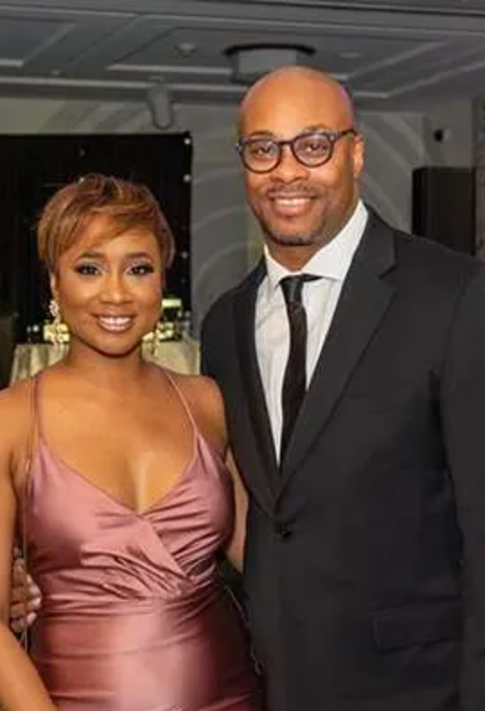
Recap
Focus on Core Strategies
  Maximize success with major gift donors before the event begins.
  Invite supporters to be partners in philanthropic success - not passive attendees.
  Empower the board and colleagues to begin fruitful conversations with guests.
  Keep the CEO and Chief Fundraiser focused on donor moves and connections.
  Follow up effectively, quickly, and with gratitude.

Slide 28

Q&A

Slide 29

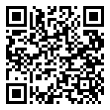
Keep the Convo Going!
Got questions or need a strategy boost?
Join me for a 1-hour Open Coaching Session for BetterUnite clients only where I’ll answer your questions and help you take your event or major donor strategies to the next level.
Scan the QR code to reserve your spot! Let’s tackle your challenges and maximize your impact together.

